Slide 1
Kevin Tran Prepared by Kevin Tran

Slide 2

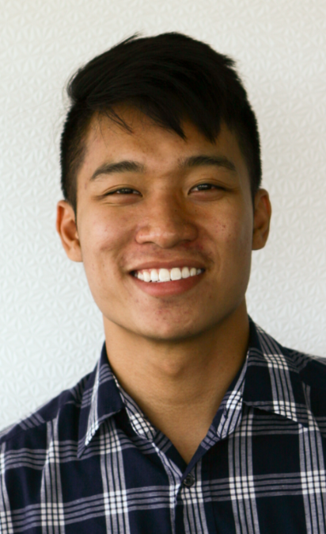
Me
UX Intern
Currently studying Human-Computer Interaction and Computer Science at UC San Diego
I have uneven foot arches
In my free time I like to
Design
Play videogames
Follow the NFL
Stay active
Potato on my couch and watch Netflix
Read about thought experiments (recent)

Slide 3
What I worked on!
AirMini
-User testing for Test Drive and Troubleshooting
myAir web
-User research, unmoderated user testing
ResAssist (internal app)
-User research and design
Misc.
-Screen designs
-User flows
UX RESEARCH

Slide 4

ResAssist
Final name TBD

Slide 5
Overview
Question
What do ResMed employees need out of an internal app?
Usability Testing
3 rounds
21 users
I was in charge of:
User Research
UX Design, wireframing
Thanks to Rafael for doing the visual design!
UX RESEARCH

Slide 6
The purpose of ResAssist
“To facilitate the daily life of a ResMed employee”

Slide 7
ResAssist v1

Slide 8
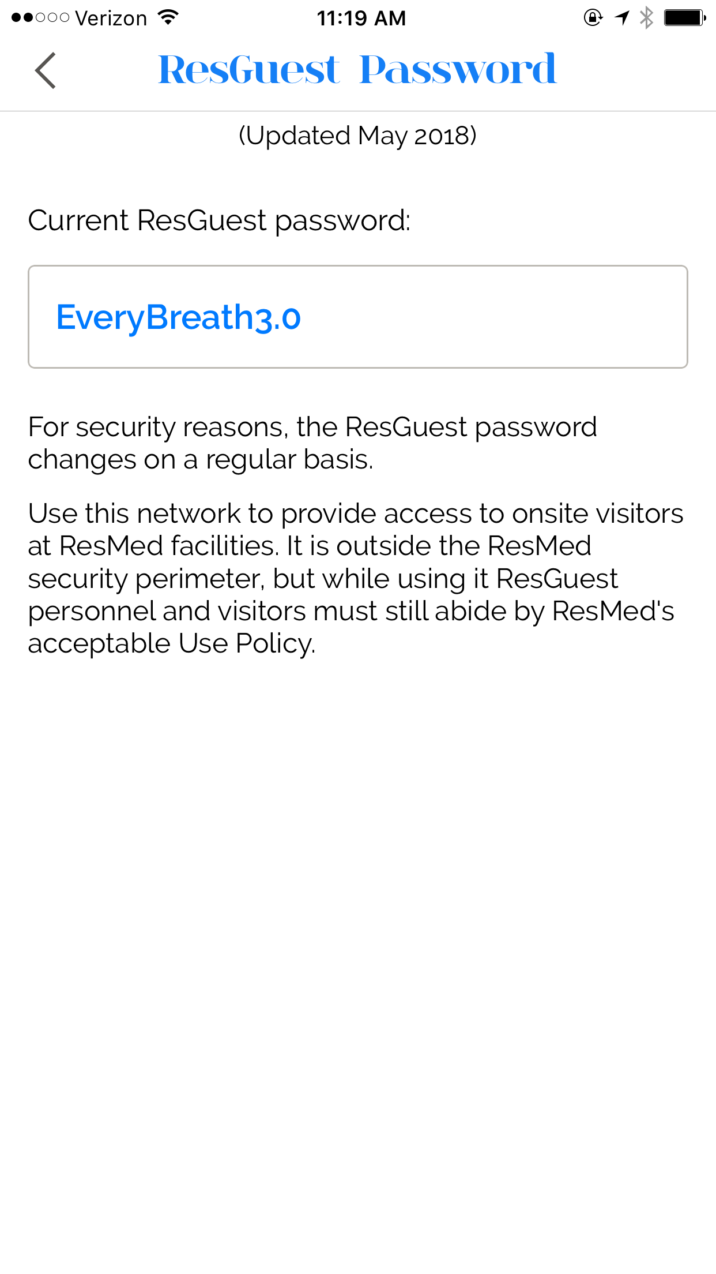
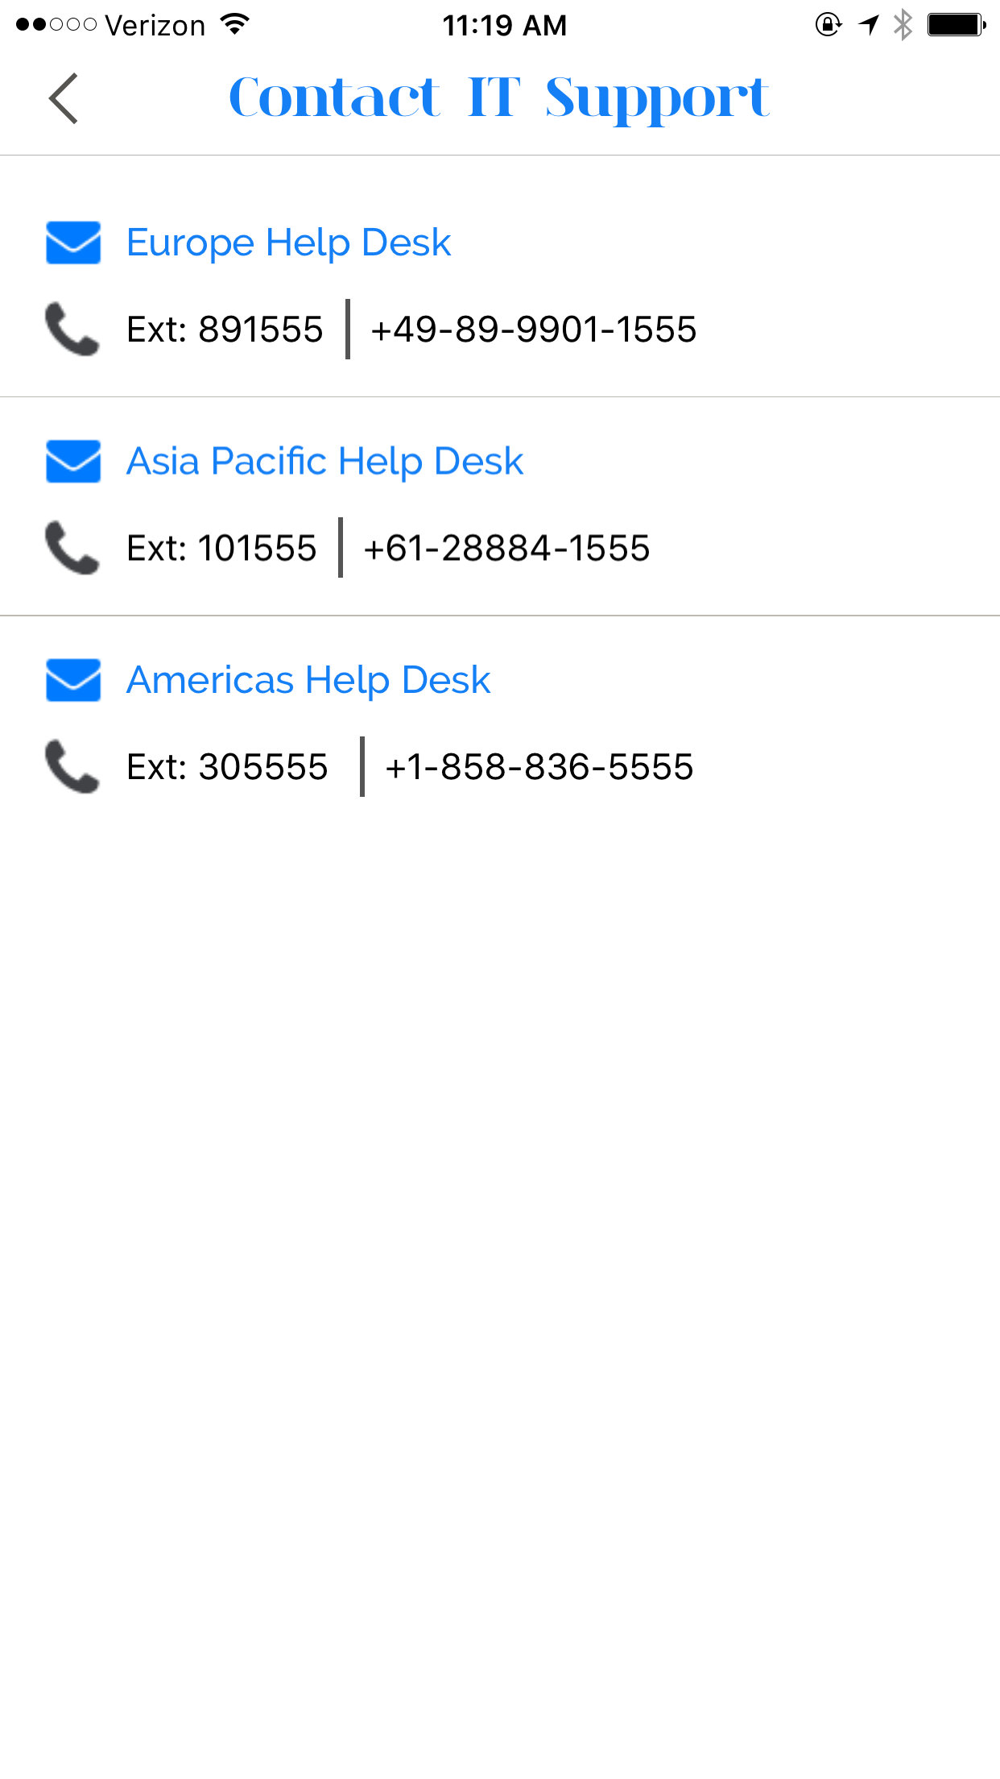
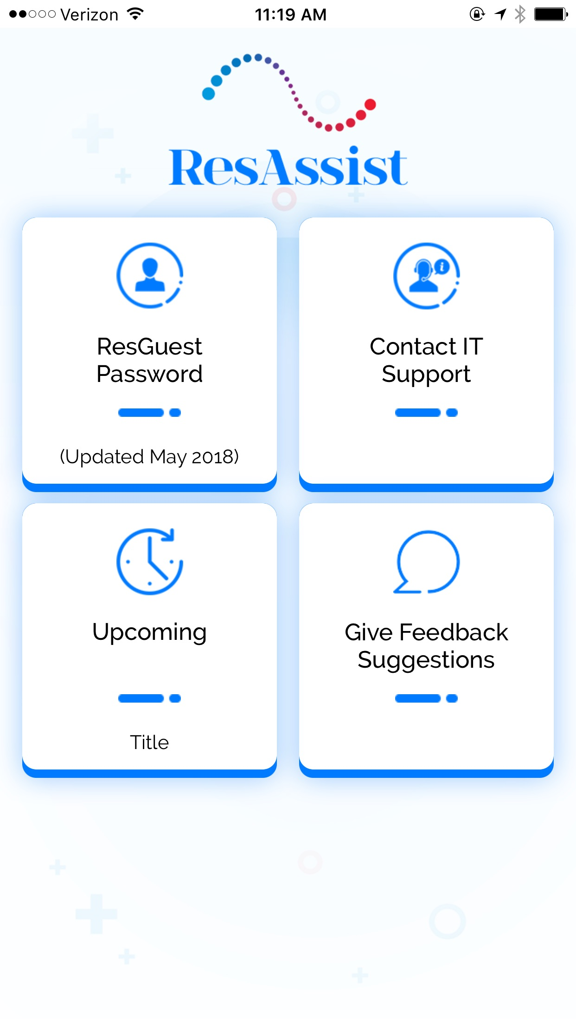
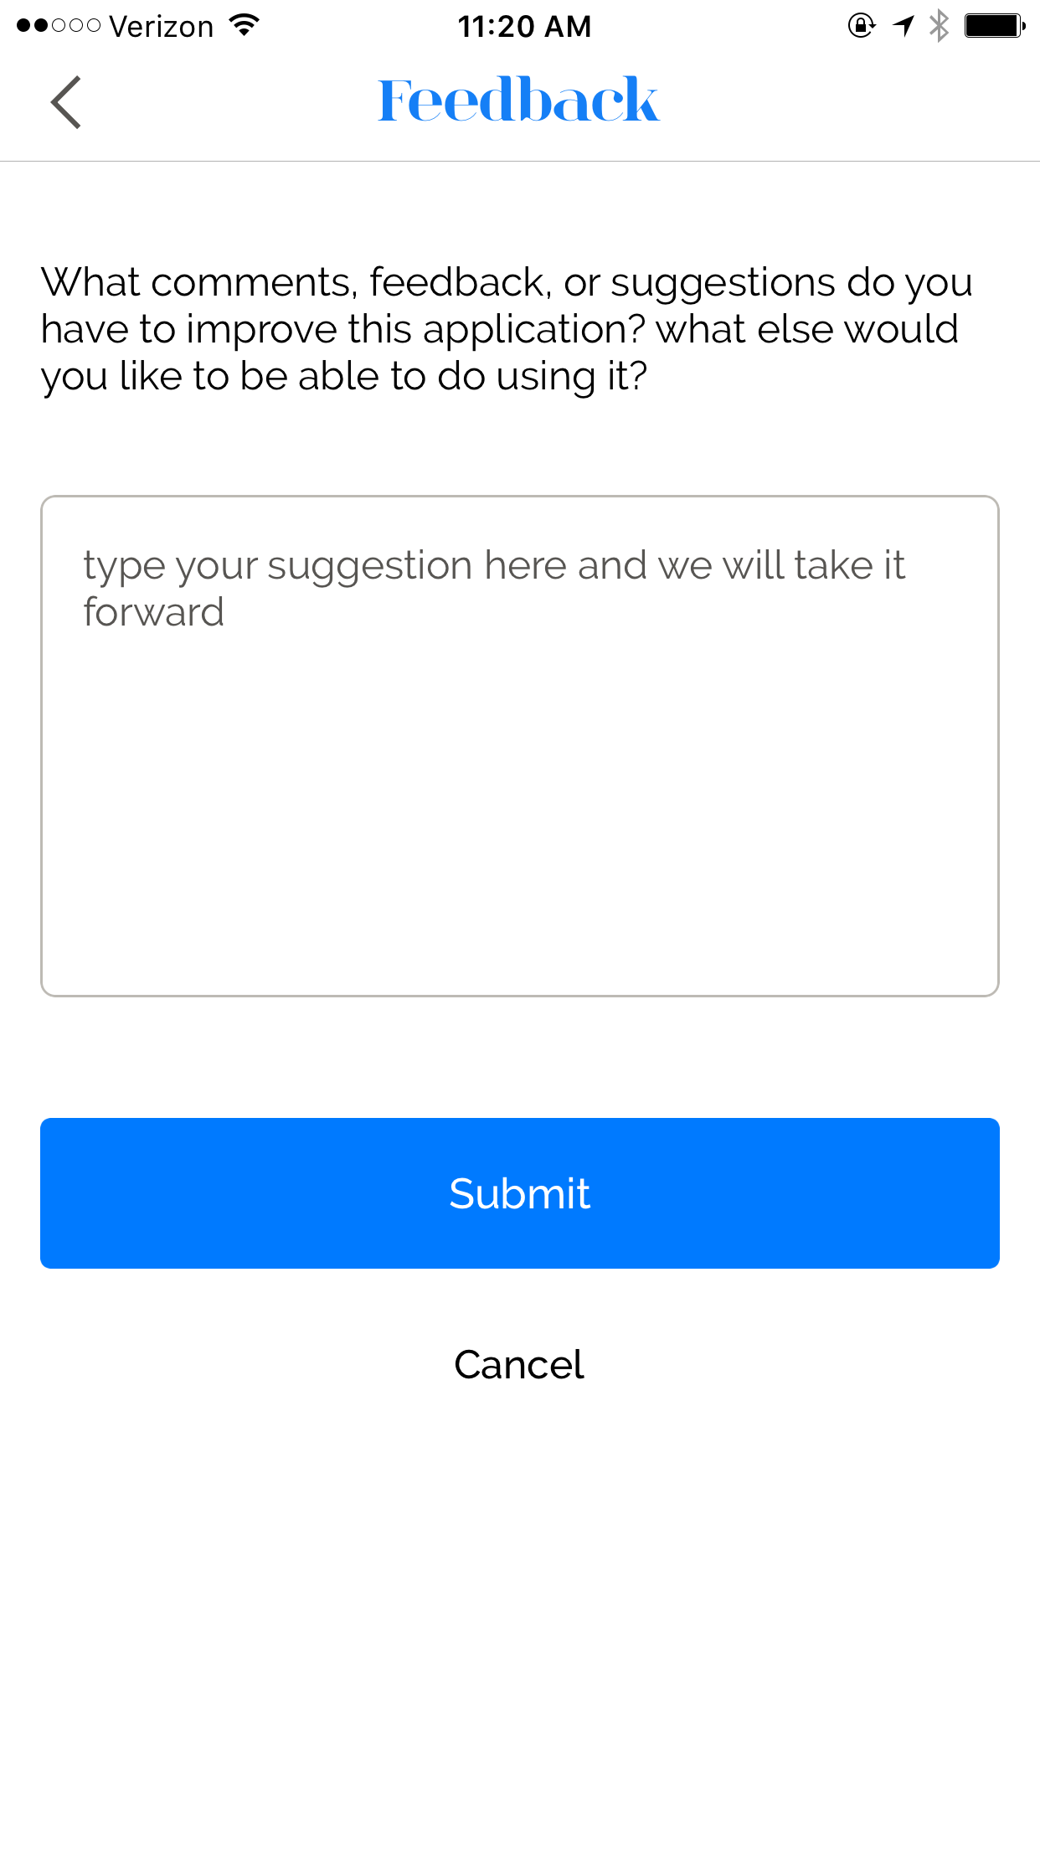
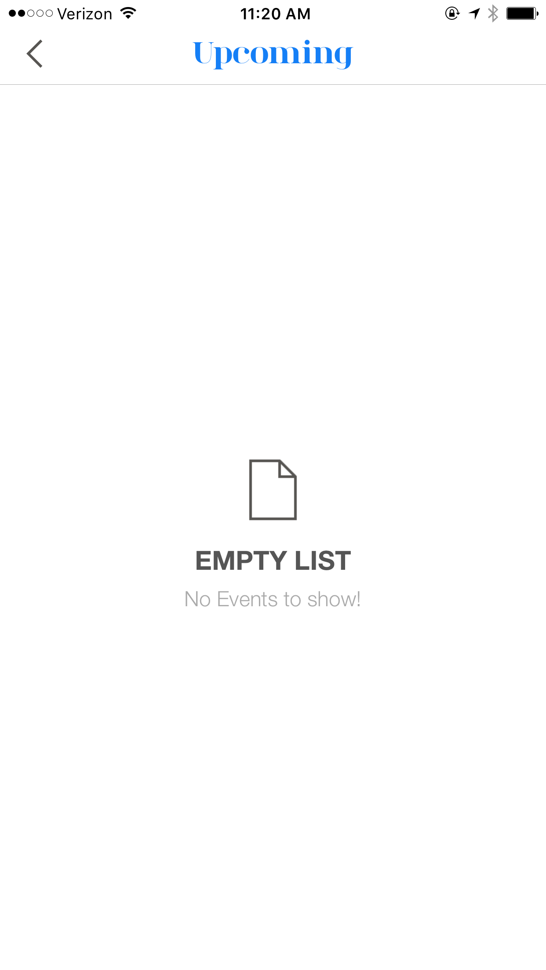
ResAssist User Flows
UX RESEARCH

Slide 9
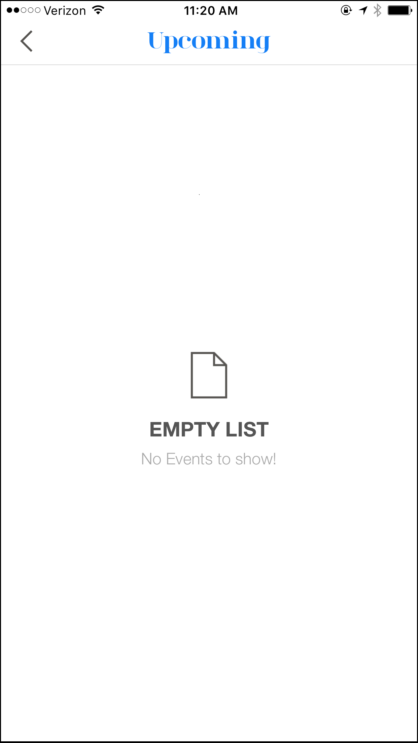
Wi-Fi Password
Wi-Fi difficult to access
Lack of relevant info
Inconsistency between icons
UX RESEARCH

Slide 10
ResAssist
Users see no value in ResAssist
They see no value in the way it is currently designed; they have no reason to open the app.
UX RESEARCH

Slide 11
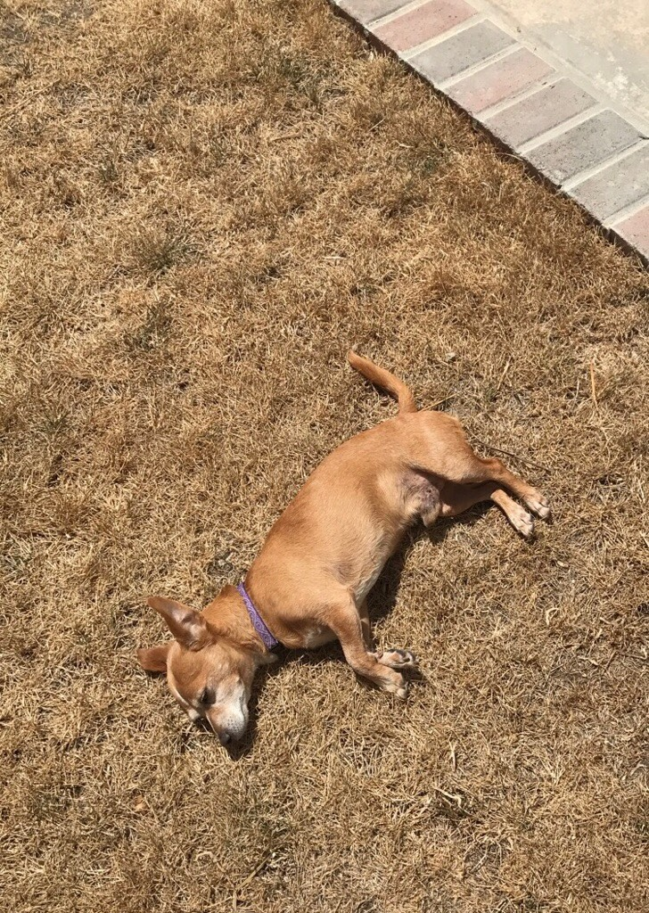
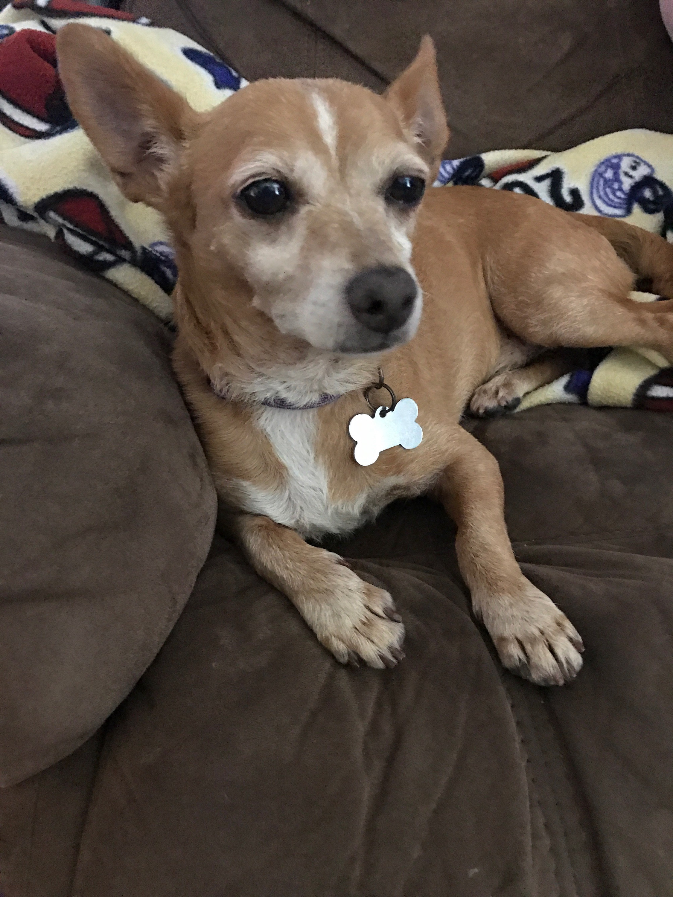
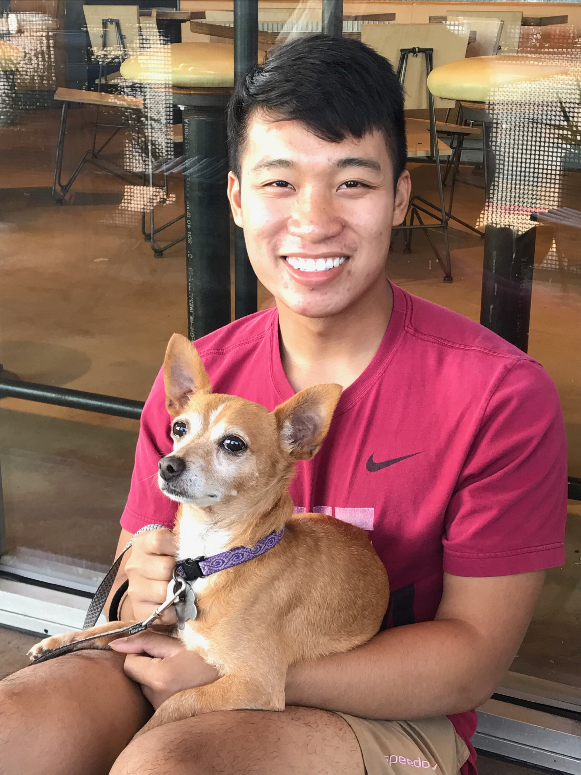
Dobby

Slide 12
Creating value
How could we hope to create value?
Why would an employee want to open ResAssist?
UX RESEARCH

Slide 13
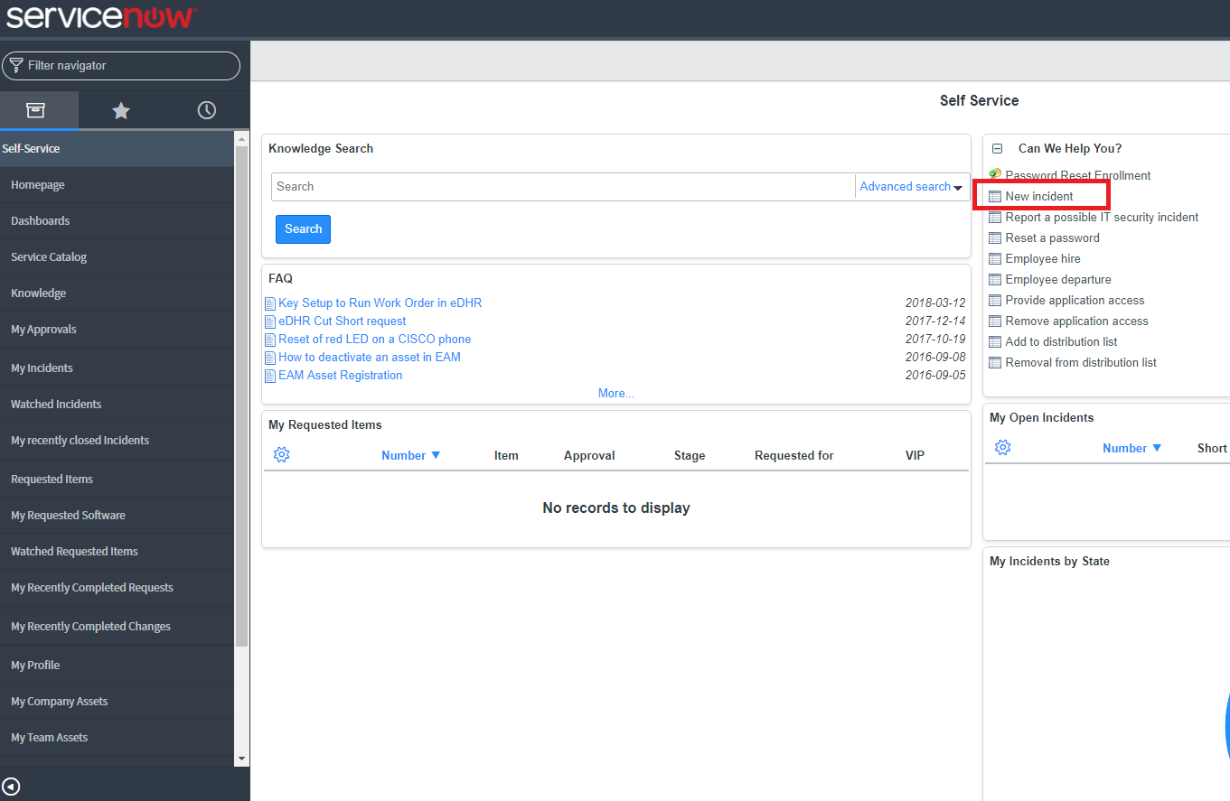
Ticketing system
ServiceNow integration
Implementing ServiceNow (SNOW) tickets in an app would encourage app use and increase usefulness.
UX RESEARCH

Slide 14
Easy Wi-Fi access
People want easier access to the Wi-Fi password
Users don’t even want to click one button to view the Wi-Fi password.
UX RESEARCH

Slide 15
ResAssist v2

Slide 16

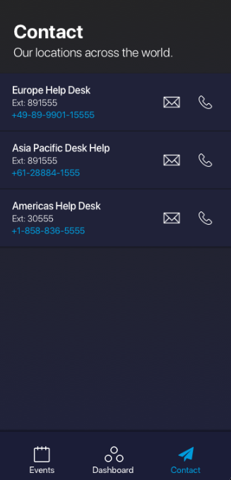
ResAssist v2
ResAssist v2
UX RESEARCH

Slide 17
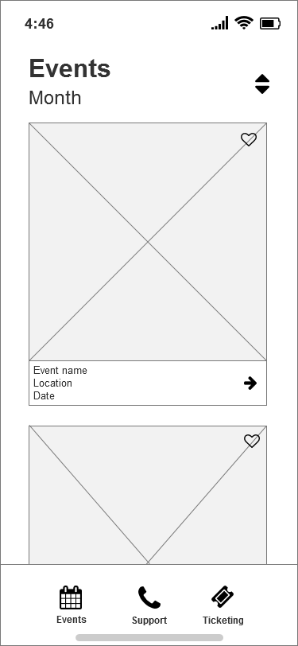
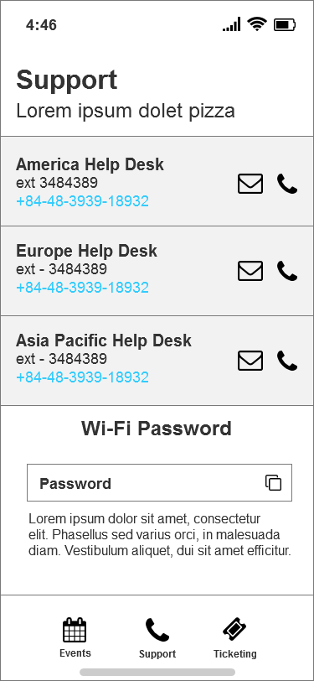
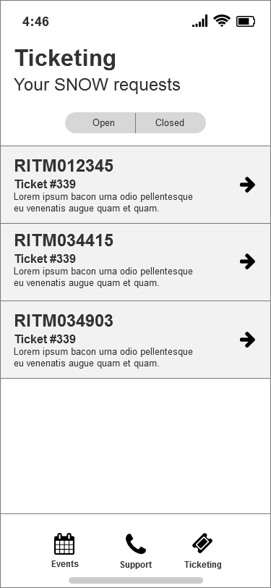
Wireframes
Events
Support
Ticketing
UX RESEARCH

Slide 18
Support page != homepage
The homepage doesn’t look like a homepage!
Reorganize the layout!
The “home screen” after logging in
UX RESEARCH

Slide 19
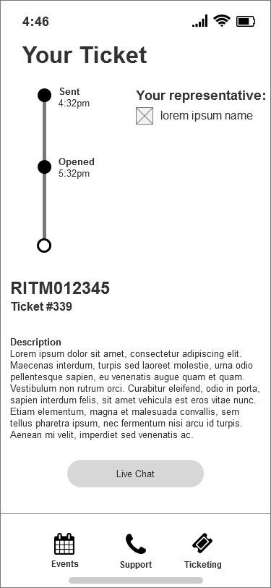
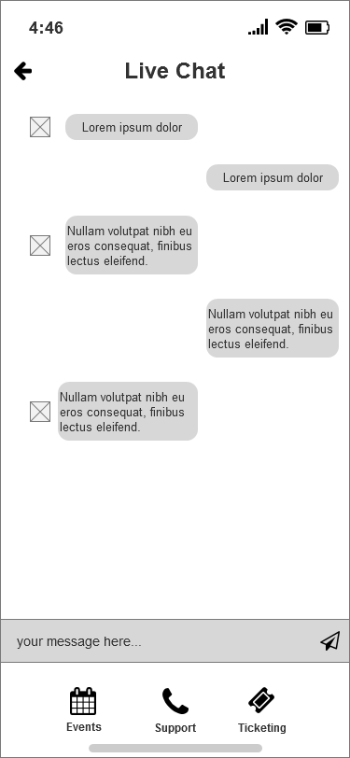
Ticketing user flow
UX RESEARCH

Slide 20
Ticketing details
More details!
Make it clear that it is ticketing for ServiceNow
Live chat was praised because it humanizes the ticketing experience
Include more details about the ticket itself (open, closed, etc).
UX RESEARCH

Slide 21
ResAssist v3

Slide 22

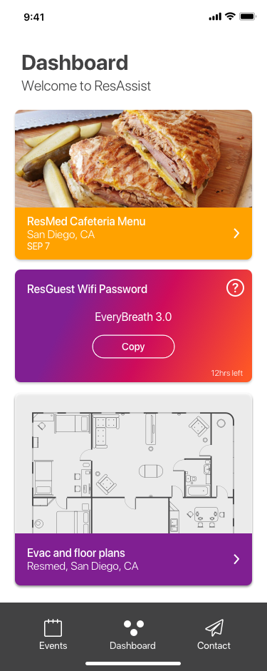
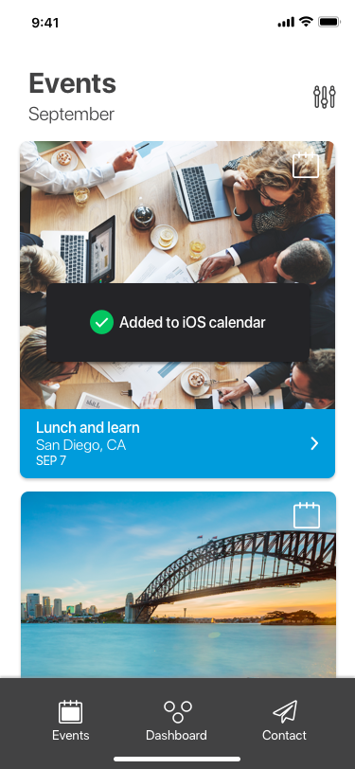
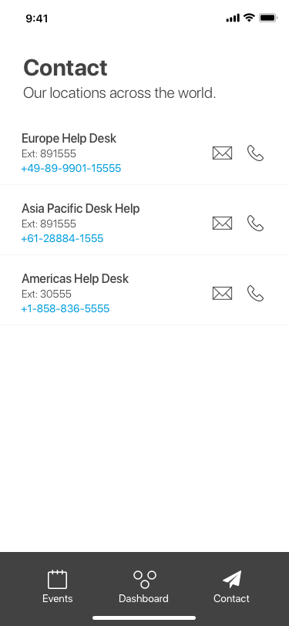
ResAssist screens
UX RESEARCH

Slide 23

Workday of a ResMed employee
Employees like getting work done
UX RESEARCH

Slide 24
Need: Dynamic dashboard
A dynamic dashboard
Because the dashboard is the hub of all important information, users want it to be customizable and dynamic. It is the first page the user sees, so a static greeting screen turns people away.
UX RESEARCH

Slide 25
User Interface: Color
A division between color
Red/Blue color scheme
Consistent with ResMed brand; easily recognizable as associated with ResMed
Other color scheme
Gives employees a break from “work” at ResMed
Bad colors could be harsh on the eyes
UX RESEARCH

Slide 26

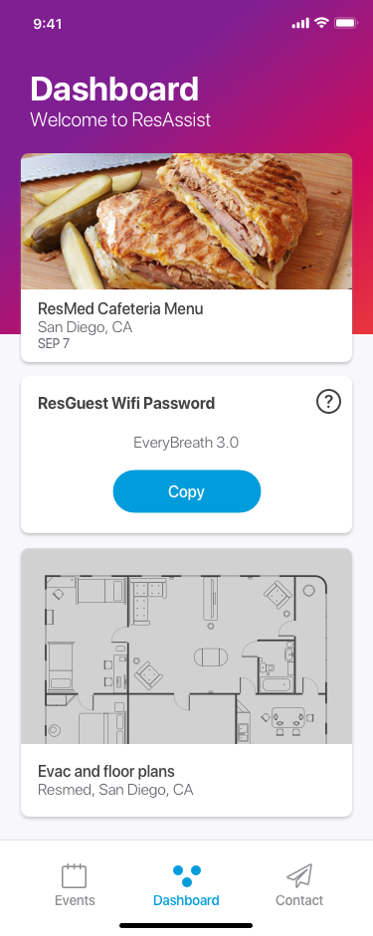
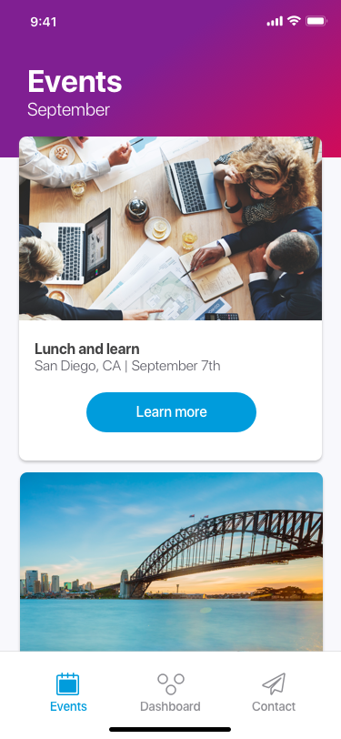
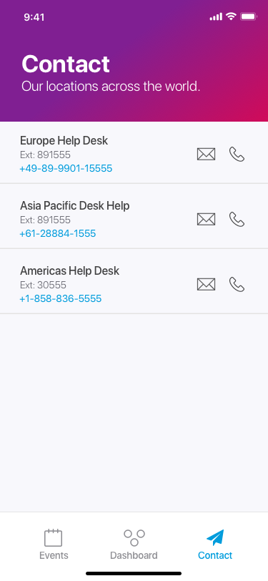
Current ResAssist screens (v4)
UX RESEARCH

Slide 27
Future
For the future
Increased content
Another set of visual updates
Another round of user testing
UX RESEARCH

Slide 28
Thank you for the opportunity!

